Slide 1
React State Management
Built-In State Management and Libraries
Notes:
What I’ll be presenting on today is React State Management:
We’ll talk about:
What state management is and why its important
What React provides for us out of the box to manage our application’s state
And a couple of popular libraries written to help us manage state
Some of these examples will be straight from the React docs or from the libraries we’ll look at, so I’ll provide links at the end if you’re want to re-review or dig deeper into anything we cover

Slide 2
Why talk about State Management?
UI and State are fundamental elements of any application
Notes:
So, why are we talking about state management?
Well:
UI and state are fundamental elements of any application, let’s think about this quote from ui.dev
“If you were to boil down an app to its two most fundamental components, what you'd get is UI and State.”
So, what that quote is saying is that, two core elements of any app are the UI you interact with, and the state changes that occur when you interact with that UI.
If you think about the business rules in the app, again, it’s our state that changes in coordination with those rules.
So, an app is composed primarily of UI and State.
Now, here’s some more on the quote from above:
“if you were to boil down the root cause for any bug you've ever written, odds are that bug was caused because of state mismanagement. The state the app expected and the state it got were out of sync.
Have you ever thought about why the first rule of tech support is turning it off and back on again? It's because it resets the state and, therefore, fixes the problem.”
So, by increasing the predictability of your state, you can decrease the number of bugs in your application.
And that’s why state management is important.
What is the Store? - ui.dev

Slide 3
Built-In State Management in React
Notes:
Now that we understand why state management is important, let’s talk about the state management tools we’re given out of the box with React.
But before we do that,
it’s important to understand first that React embraces and emphasizes declarative programming, as opposed to imperative programming.

Slide 4
Reacting to Input with State
“React uses a declarative way to manipulate the UI.
Instead of manipulating individual pieces of the UI directly, you describe the different states that your component can be in, and switch between them in response to the user input.
This is similar to how designers think about the UI.”
Notes:
So, the React docs read,
“With React, you won’t modify the UI from code directly. For example, you won’t write commands like “disable the button”, “enable the button”, “show the success message”, etc. Instead, you’ll describe the UI you want to see for the different visual states of your component (“initial state”, “typing state”, “success state”), and then trigger the state changes in response to user input. This is similar to how designers think about UI.”
This is an important concept to understand, and I think an easy one to understand as well with the right mental model.
A metaphor that worked well for me was to make the distinction is that imperative programming would be like if you asked someone for directions to their house,
An imperative response might be:
Managing State – React
Imperative vs Declarative Programming (ui.dev)
Reacting to Input with State – React

Slide 5
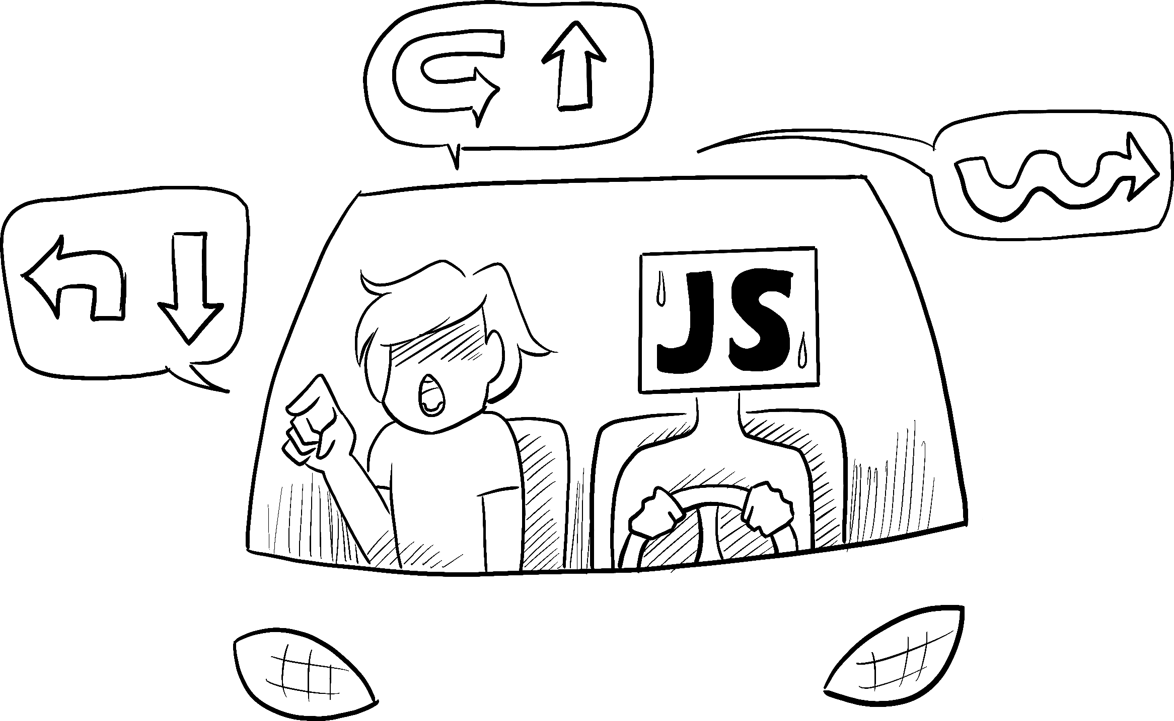
Notes:
IMPERATIVE
Go out of the north exit of the parking lot and take a left. Get on I-15 going North until you get to the 12th street exit. Take a right off the exit like you’re going to Ikea. Go straight and take a right at the first light. Continue through the next light then take your next left. My house is #298.

Slide 6
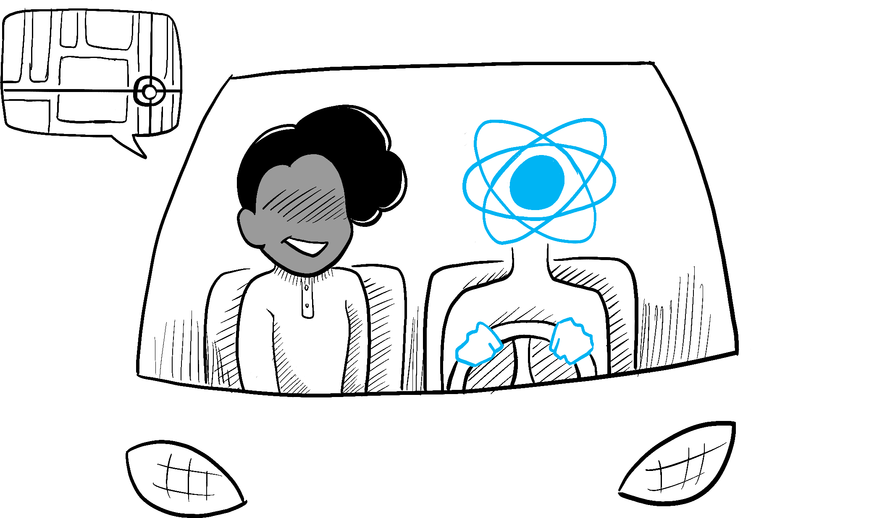
Notes:
A declarative response would be
DECLARATIVE
My address is 298 West Immutable Alley, Eden, Utah 84310

Slide 7
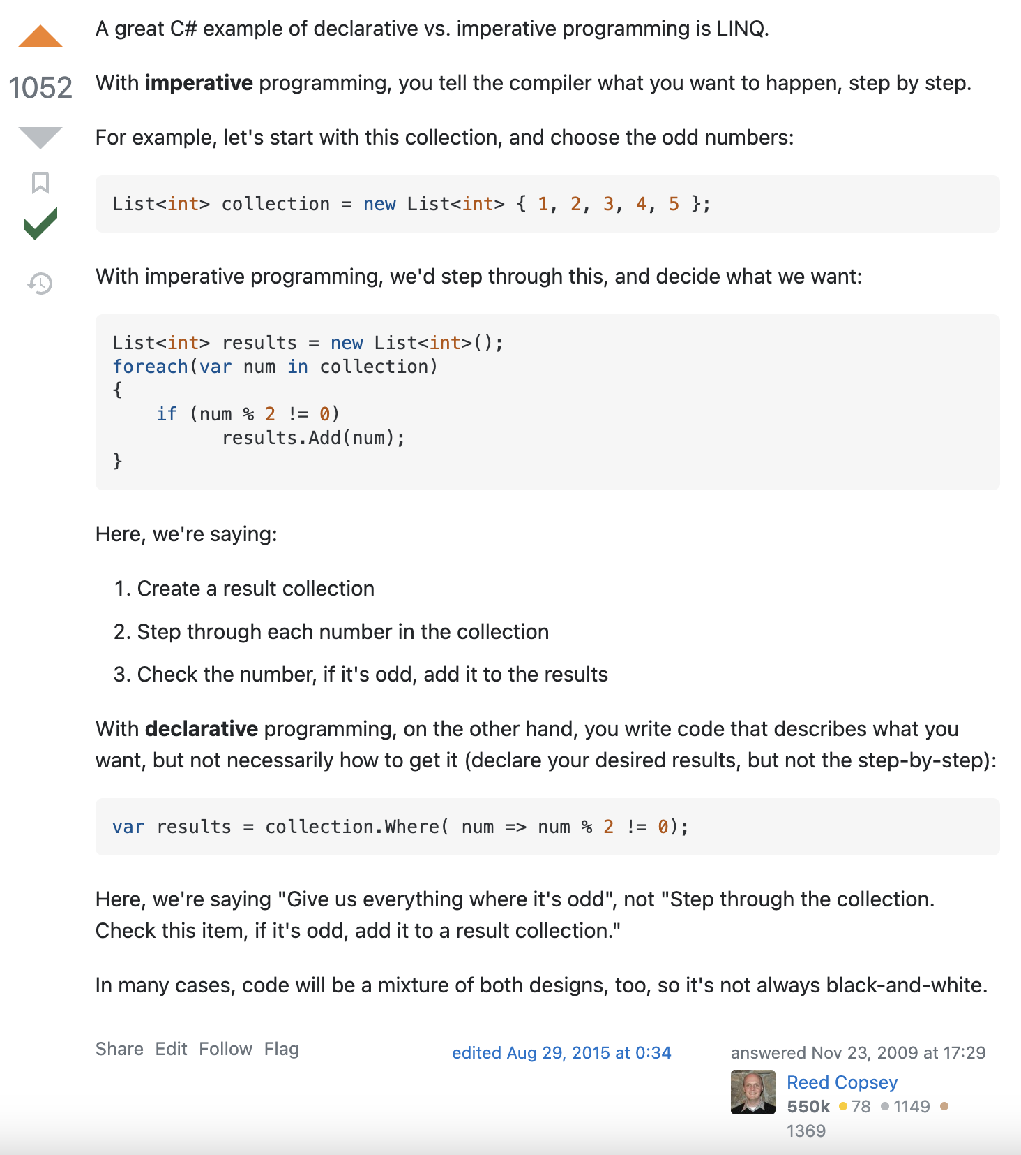

Slide 8
Notes:
https://codesandbox.io/s/kpgmzv?file=/index.js&utm_medium=sandpack
https://codesandbox.io/s/5cw764?file=/App.js&utm_medium=sandpack

Slide 9
useState
const themeArray = React.useState('light')
const theme = themeArray[0]
const setTheme = themeArray[1]
...
theme // 'light'
setTheme('dark')
theme // 'dark'
Notes:
useState comes built-in with React and can be accessed via React.useState. It takes in a single argument, the initial value for that piece of state, and returns an array with the first item being the state value and the second item being a way to update that state.
The canonical and more precise way to write the code above is to use Array destructuring and put it all on one line. You can see that in the full example here.

Slide 10
useState
function Theme() {
const [theme, setTheme] = React.useState("light");
const toDark = () => setTheme("dark");
const toLight = () => setTheme("light");
return (
<div className={theme}>
{theme === "light" ? (
<button onClick={toDark}>🔦</button>
) : (
<button onClick={toLight}>💡</button>
)}
</div>
);
}
Notes:
The canonical and more precise way to write the code above is to use Array destructuring and put it all on one line. You can see that in the full example here.
The Mental Model
Now that we've seen a simple example for how the useState API works, before we get into more advanced use cases, it's important to have a solid mental model for the actual functionality that it provides.
Namely, useState allows you to trigger a component re-render, and it can preserve values between renders.
Trigger Re-renders
The concept here is the same as before when we'd invoke setState. Whenever you invoke the updater function that useState gives you, assuming the argument you pass in is different from the current state value, React will cause a re-render to the component, updating the UI.
Preserve Values
Typically when you invoke a function in JavaScript, unless you're utilizing closures, you expect any values defined in that function to get garbage collected once the function is finished executing and you expect each subsequent call to that function to produce its own unique values.
Because React Components are now just functions, naturally you may want to apply the same intuition to them. However, if that were the case, React wouldn't work. The whole point of React is that components are able to describe their UI based on their current state, View = fn(state). This implies that React, under the hood, has some way to preserve values between function calls to prevent them from being garbage collected once the function has finished executing. The public API for this, as you've seen, is useState.
The way I like to think about useState is it's the tool to preserve values between function calls/renders and to trigger a re-render of the component.

Slide 11
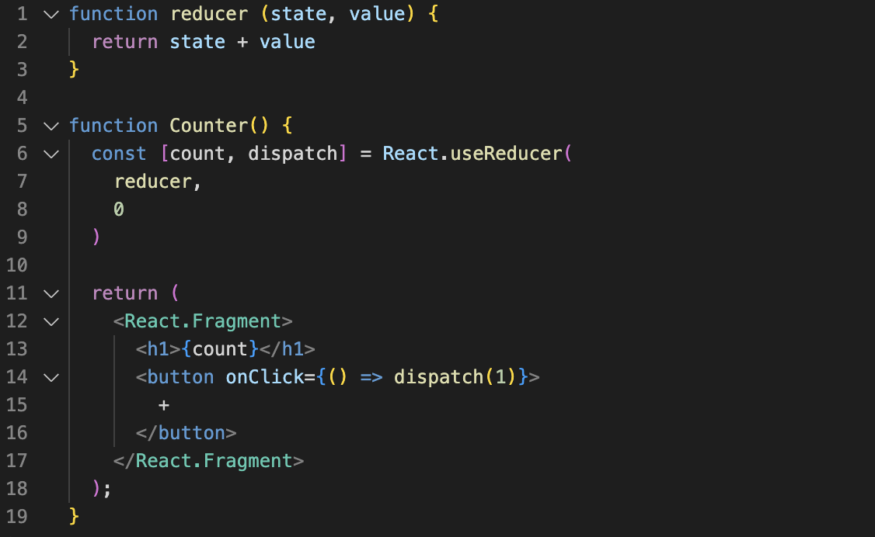
useReducer
Notes:
React comes with a built-in Hook called useReducer that allows you to add state to a function component but manage that state using the reducer pattern.
useReducer returns an array with the first element being the state and the second element being a dispatch function which when called, will invoke the reducer.
When invoked, whatever you pass to dispatch will be passed as the second argument to the reducer (which we've been calling value). The first argument (which we've been calling state) will be passed implicitly by React and will be whatever the previous state value was. Putting it all together, here's our code.
The flow is the exact same as our diagram above. Whenever the + button is clicked, dispatch will be invoked. That will call reducer passing it two arguments, state, which will come implicitly from React, and value, which will be whatever was passed to dispatch. What we return from reducer will become our new count. Finally, because count changed, React will re-render the component, updating the UI.
useState and useReducer both allow you to add state to function components. useReducer offers a bit more flexibility since it allows you to decouple how the state is updated from the action that triggered the update - typically leading to more declarative state updates.
If different pieces of state update independently from one another (hovering, selected, etc.), useState should work fine. If your state tends to be updated together or if updating one piece of state is based on another piece of state, go with useReducer.

Slide 12
useReducer
Notes:
Why/ when
https://codesandbox.io/s/usereducer-usestate-registration-0f6yw
https://codesandbox.io/s/usereducer-usereducer-registration-c0h6k

Slide 13
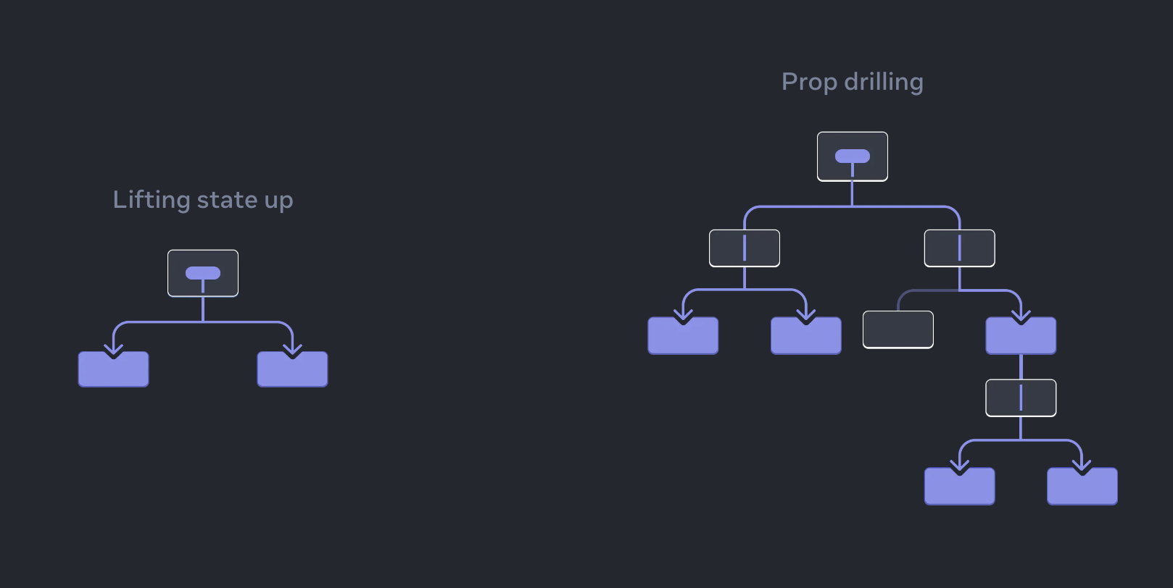
useContext
Notes:
Context provides a way to pass data through the component tree without having to pass props down manually at every level. - The React Docs
https://react.dev/learn/passing-data-deeply-with-context

Slide 14
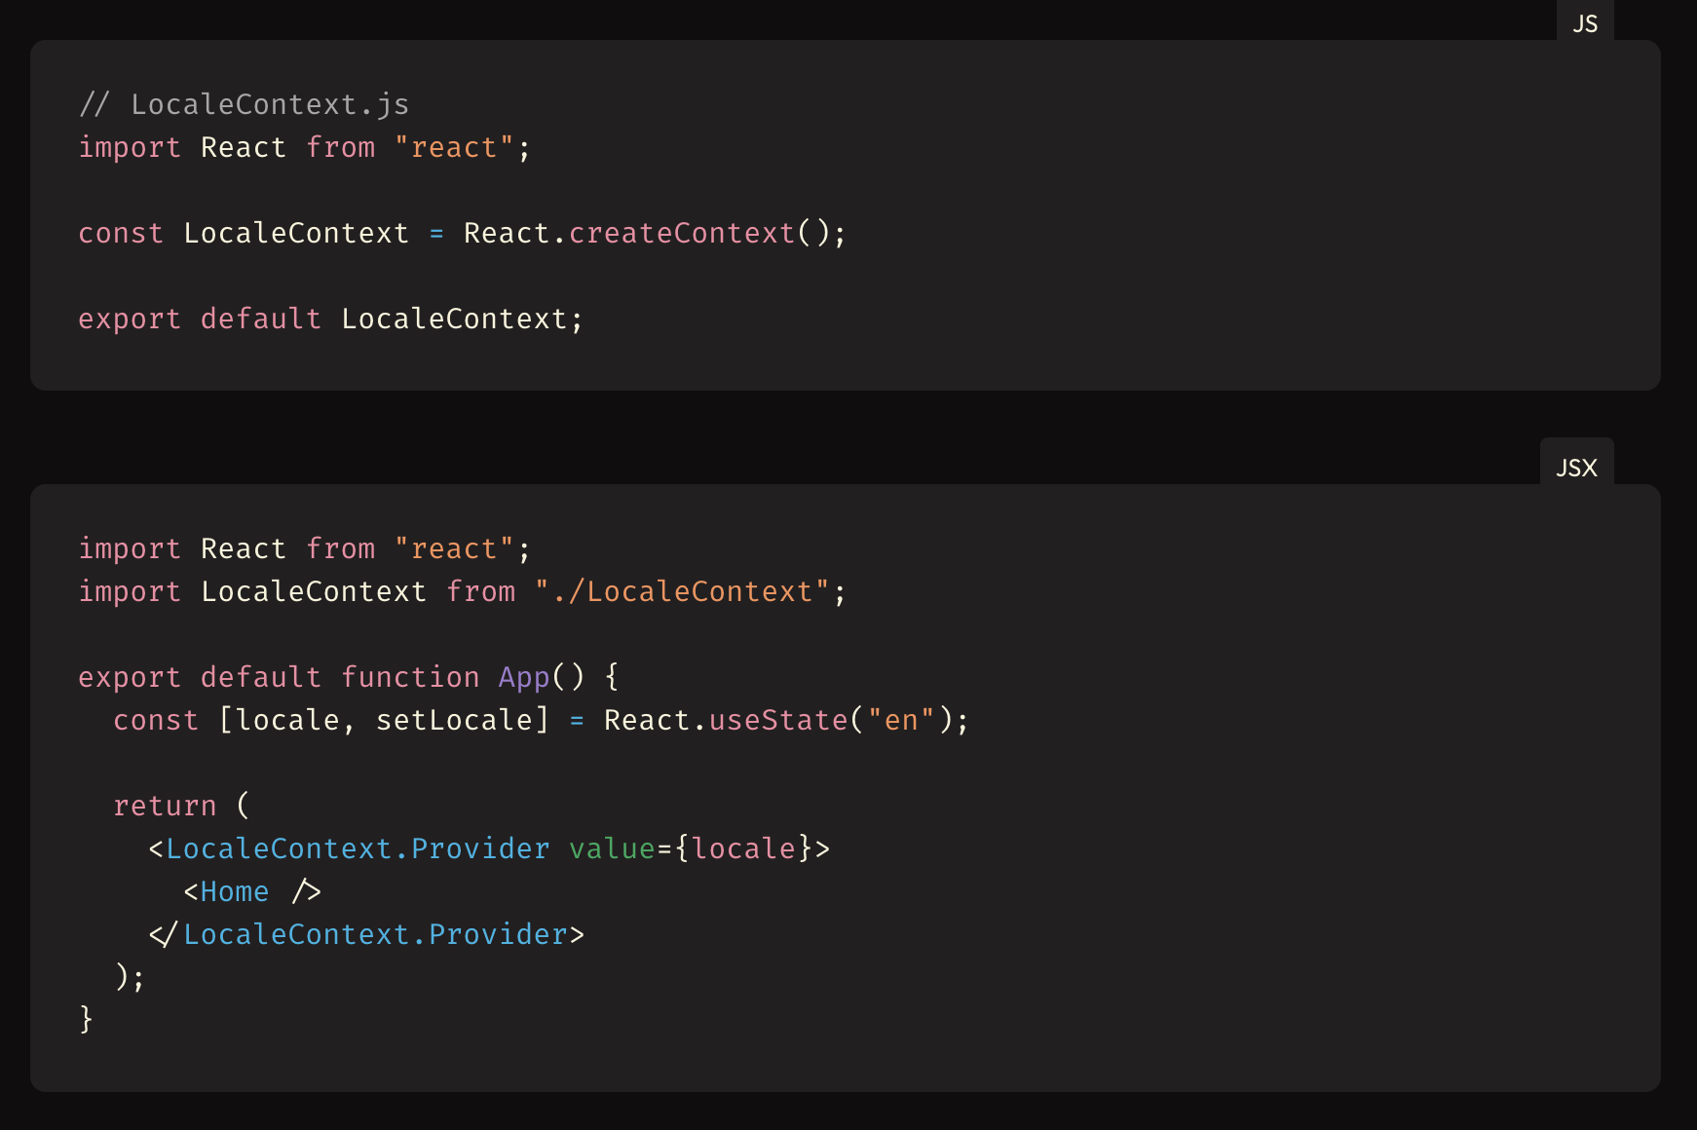
useContext - Provider
Notes:
Context provides a way to pass data through the component tree without having to pass props down manually at every level. - The React Docs
https://react.dev/learn/passing-data-deeply-with-context

Slide 15
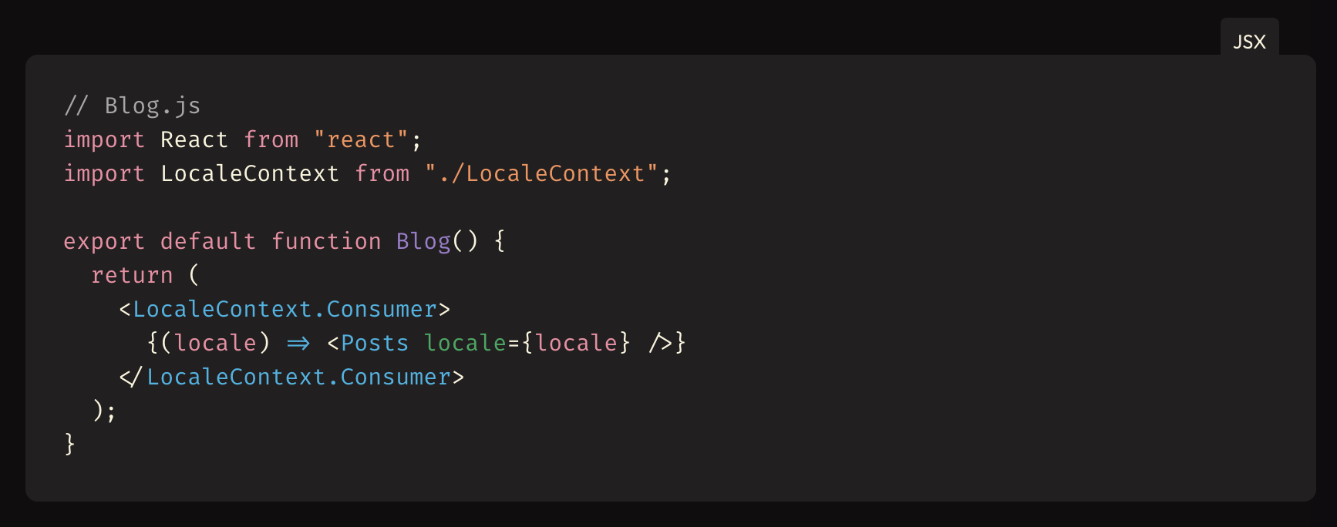
useContext - Consumer
Notes:
Context provides a way to pass data through the component tree without having to pass props down manually at every level. - The React Docs
https://react.dev/learn/passing-data-deeply-with-context

